Slide 1
Class Imbalance
Problem
By Aksadur Rahman
aksadur@yahoo.com

Slide 2
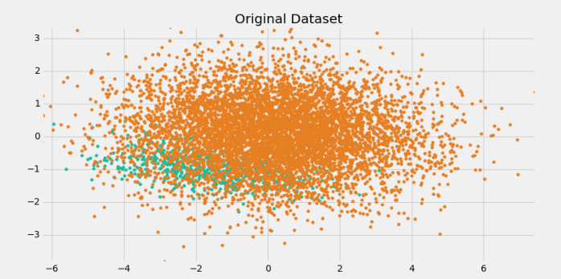

Slide 3


Slide 4
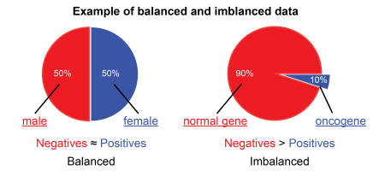

Slide 5
